Slide 1
Comparative Analysis of Satellite & Ground‑Based Ozone Measurements
By: Sallam Saka
Supervisors: Professor Kaley Walker and Dr. Paul Jeffery

Slide 2
Research Topic: Validating Ozone Data
Why Ozone Matters:
Critical UV shield for Earth; impacts climate & ecosystems.
Photochemically destroyed, causing seasonal ozone holes (especially Antarctic).
Challenge: Instruments measure ozone differently which creates data uncertainty.
Objective: Assess consistency of ozone data across ACE-FTS, OSIRIS, and PEARL FTIR.
Approach: Compare individual and aggregated measurements of the instruments.
Why This Work Matters:
Ensures reliable ozone data is consistently retrieved from instruments.
Enables evidence-based policies (e.g., Montreal Protocol).
Ross J. Salawitch, Laura A. McBride, Chelsea R. Thompson, Eric L. Fleming, Richard L. McKenzie, Karen H. Rosenlof, Sarah J. Doherty, David W. Fahey, Twenty Questions and Answers About the Ozone Layer: 2022 Update, Scientific Assessment of Ozone Depletion: 2022, 75 pp., World Meteorological Organization, Geneva, Switzerland, 2023.

Slide 3
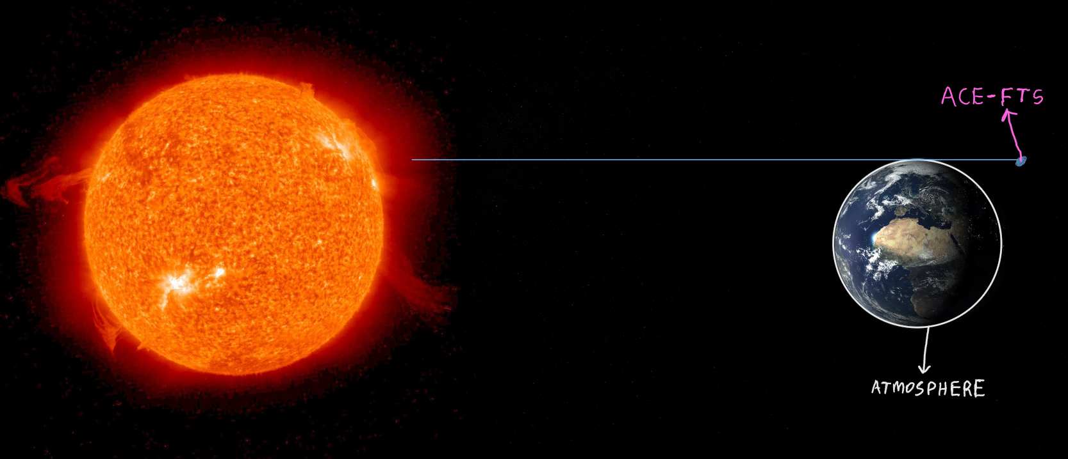
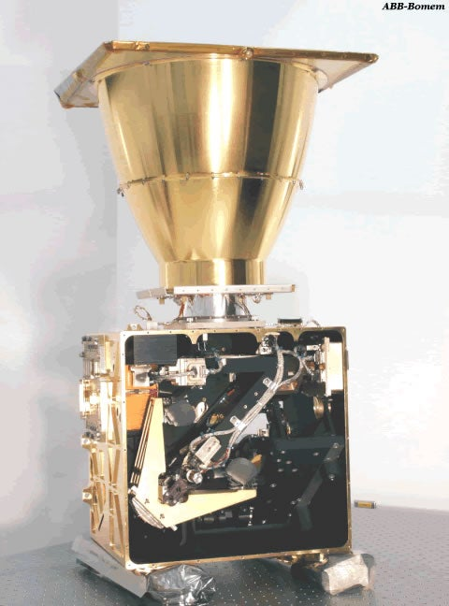
ACE-FTS
ACE-FTS is one of the two main instruments on the SCI-SAT
SCI-SAT was launched in 2003
ACE-FTS measures in the limb viewing geometry
ACE-FTS uses Fourier Transform to produce absorption spectra
Bernath, P. F., et al. (2005), Atmospheric Chemistry Experiment (ACE): Mission overview, Geophys. Res. Lett., 32, L15S01, doi:10.1029/2005GL022386
https://uwaterloo.ca/atmospheric-chemistry-experiment/instruments/ace-fts

Slide 4
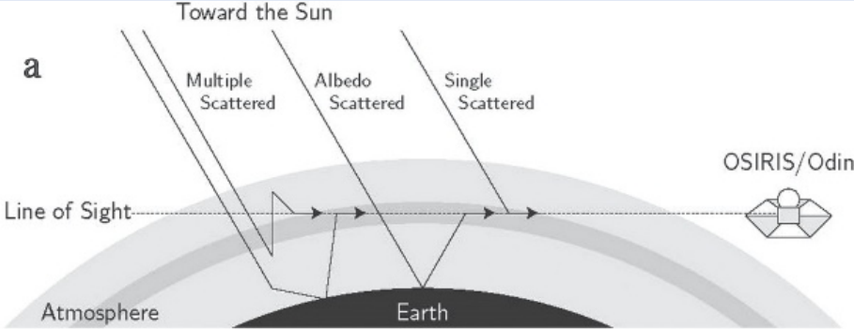
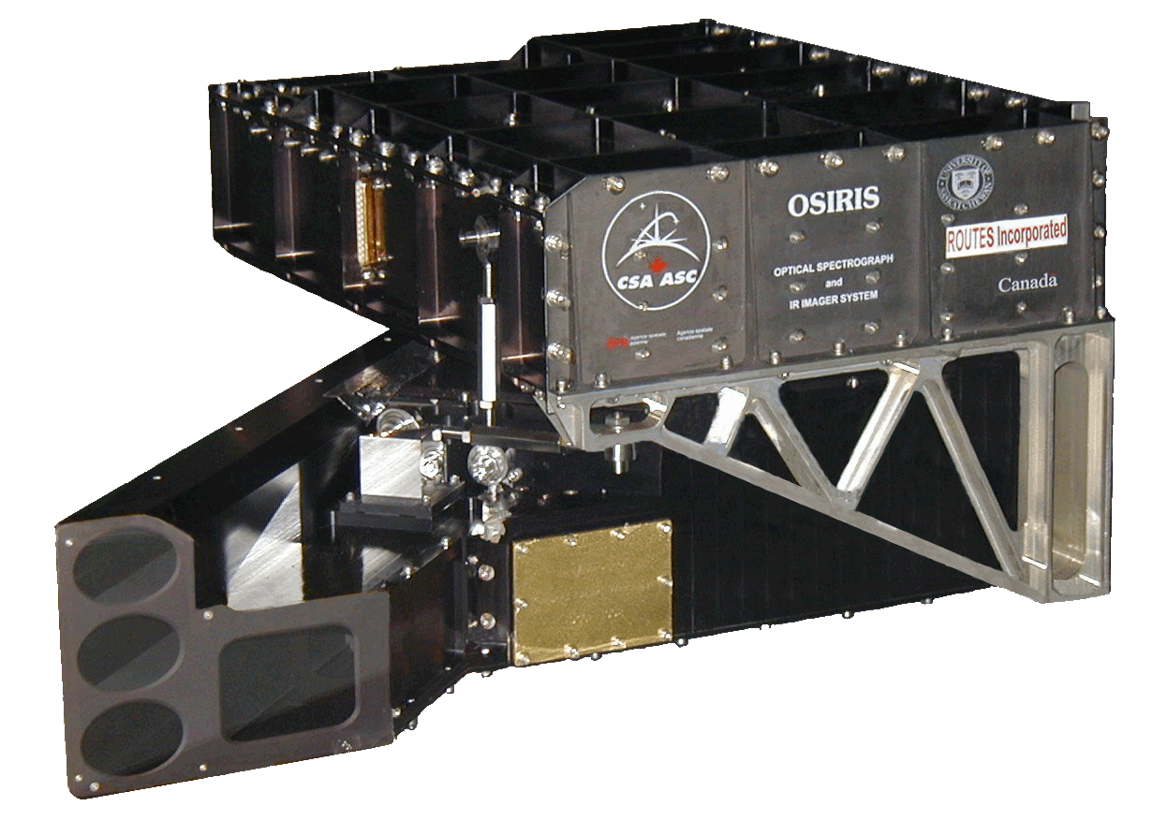
osiris
OSIRIS is on-board the ODIN satellite
ODIN was launched in 2001
OSIRIS is also pointed toward the limb of earth’s atmosphere
IRI observes both scattered sunlight and airglow emission
OS obtains spectra of scattered sunlight
McLinden, C. A., and Coauthors, 2012: OSIRIS: A Decade of Scattered Light. Bull. Amer. Meteor. Soc., 93, 1845–1863, https://doi.org/10.1175/BAMS-D-11-00135.1
Llewellyn, E. J., et al. 2004. The OSIRIS instrument on the Odin spacecraft. Canadian Journal of Physics. 82(6): 411-422. https://doi.org/10.1139/p04-005

Slide 5
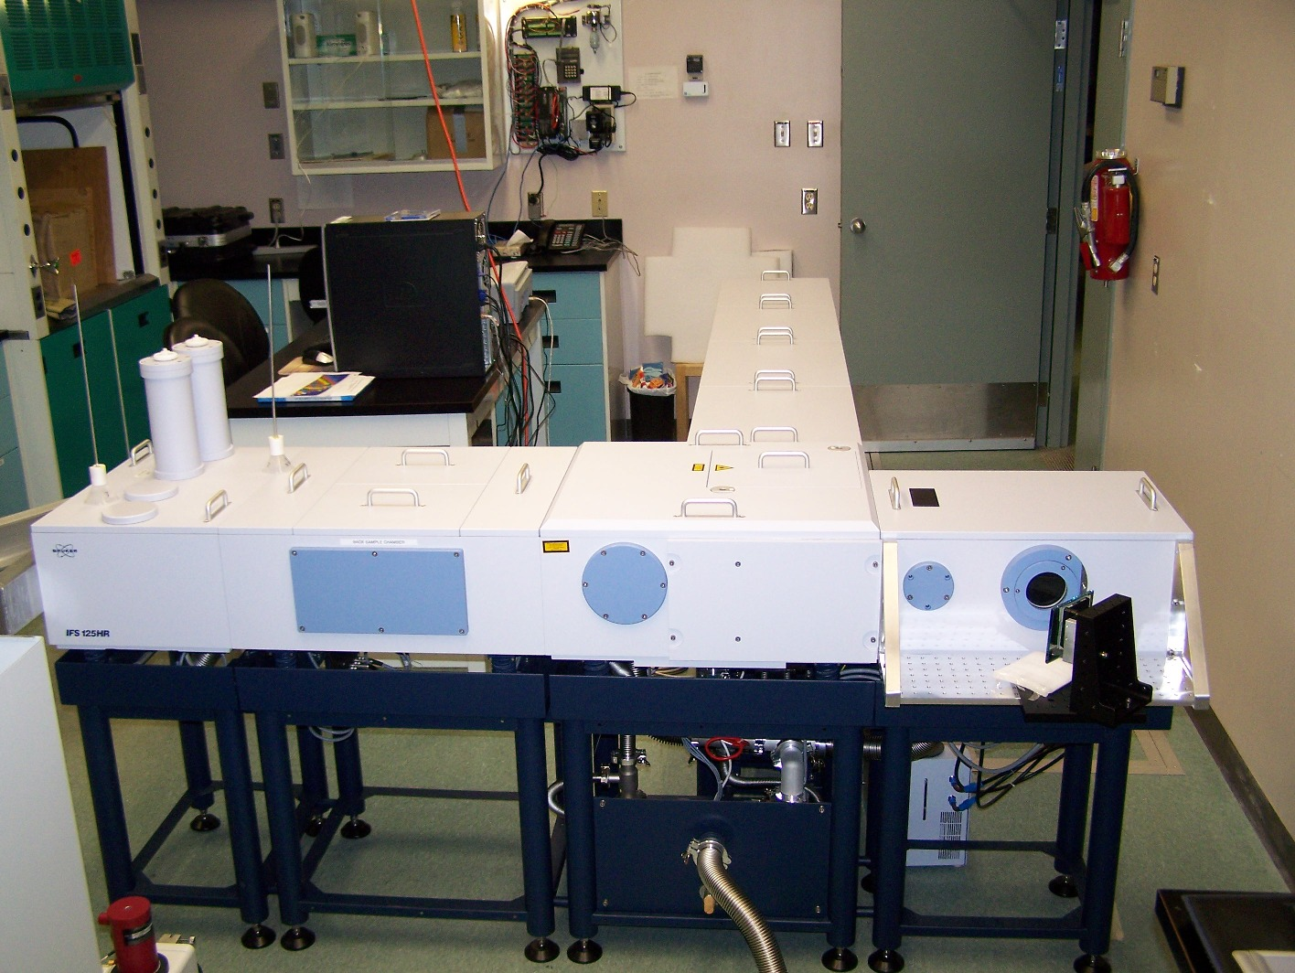
PEARL FTIR
PEARL FTIR is a ground-based instrument
PEARL FTIR is also known as Bruker FTIR
Installed permanently at PEARL in July, 2006
Measures atmospheric solar absorption while the sun has risen
https://eureka.physics.utoronto.ca/Eureka2020/Our_Instruments.html

Slide 6
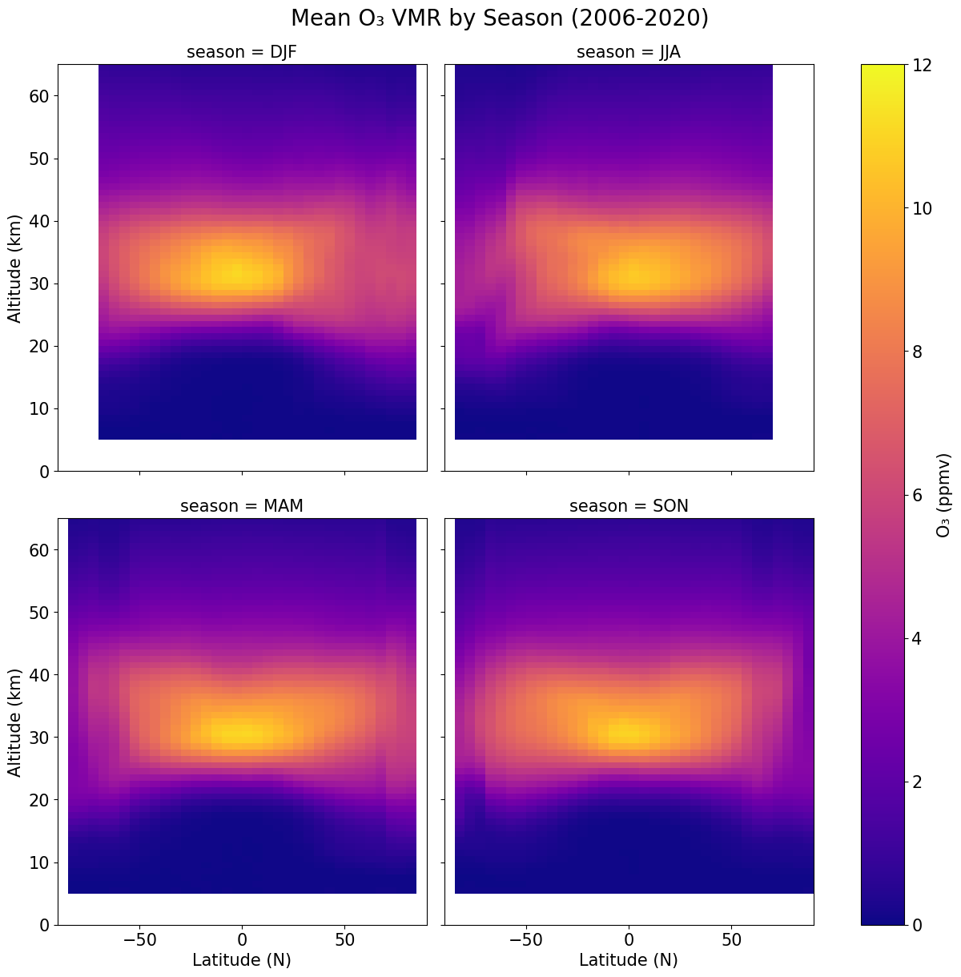
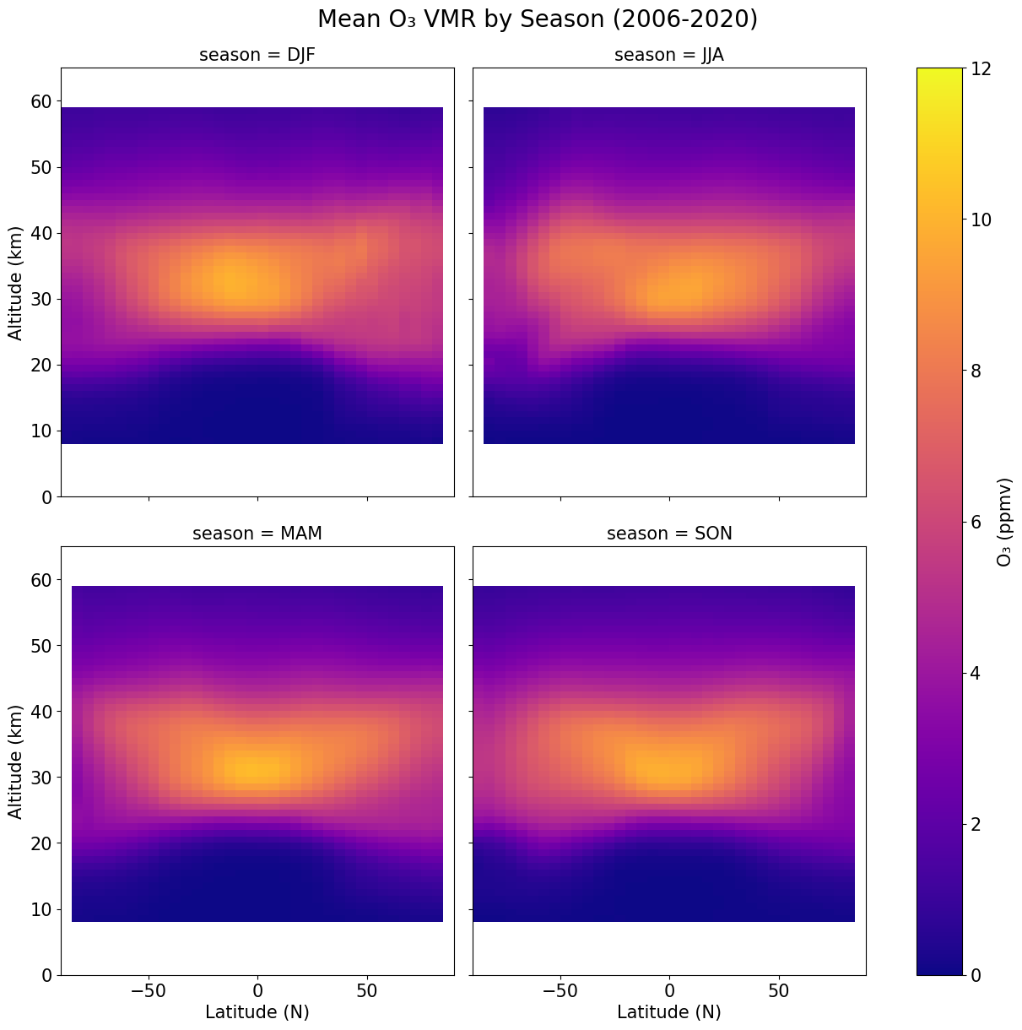
ACE-FTS
OSIRIS

Slide 7
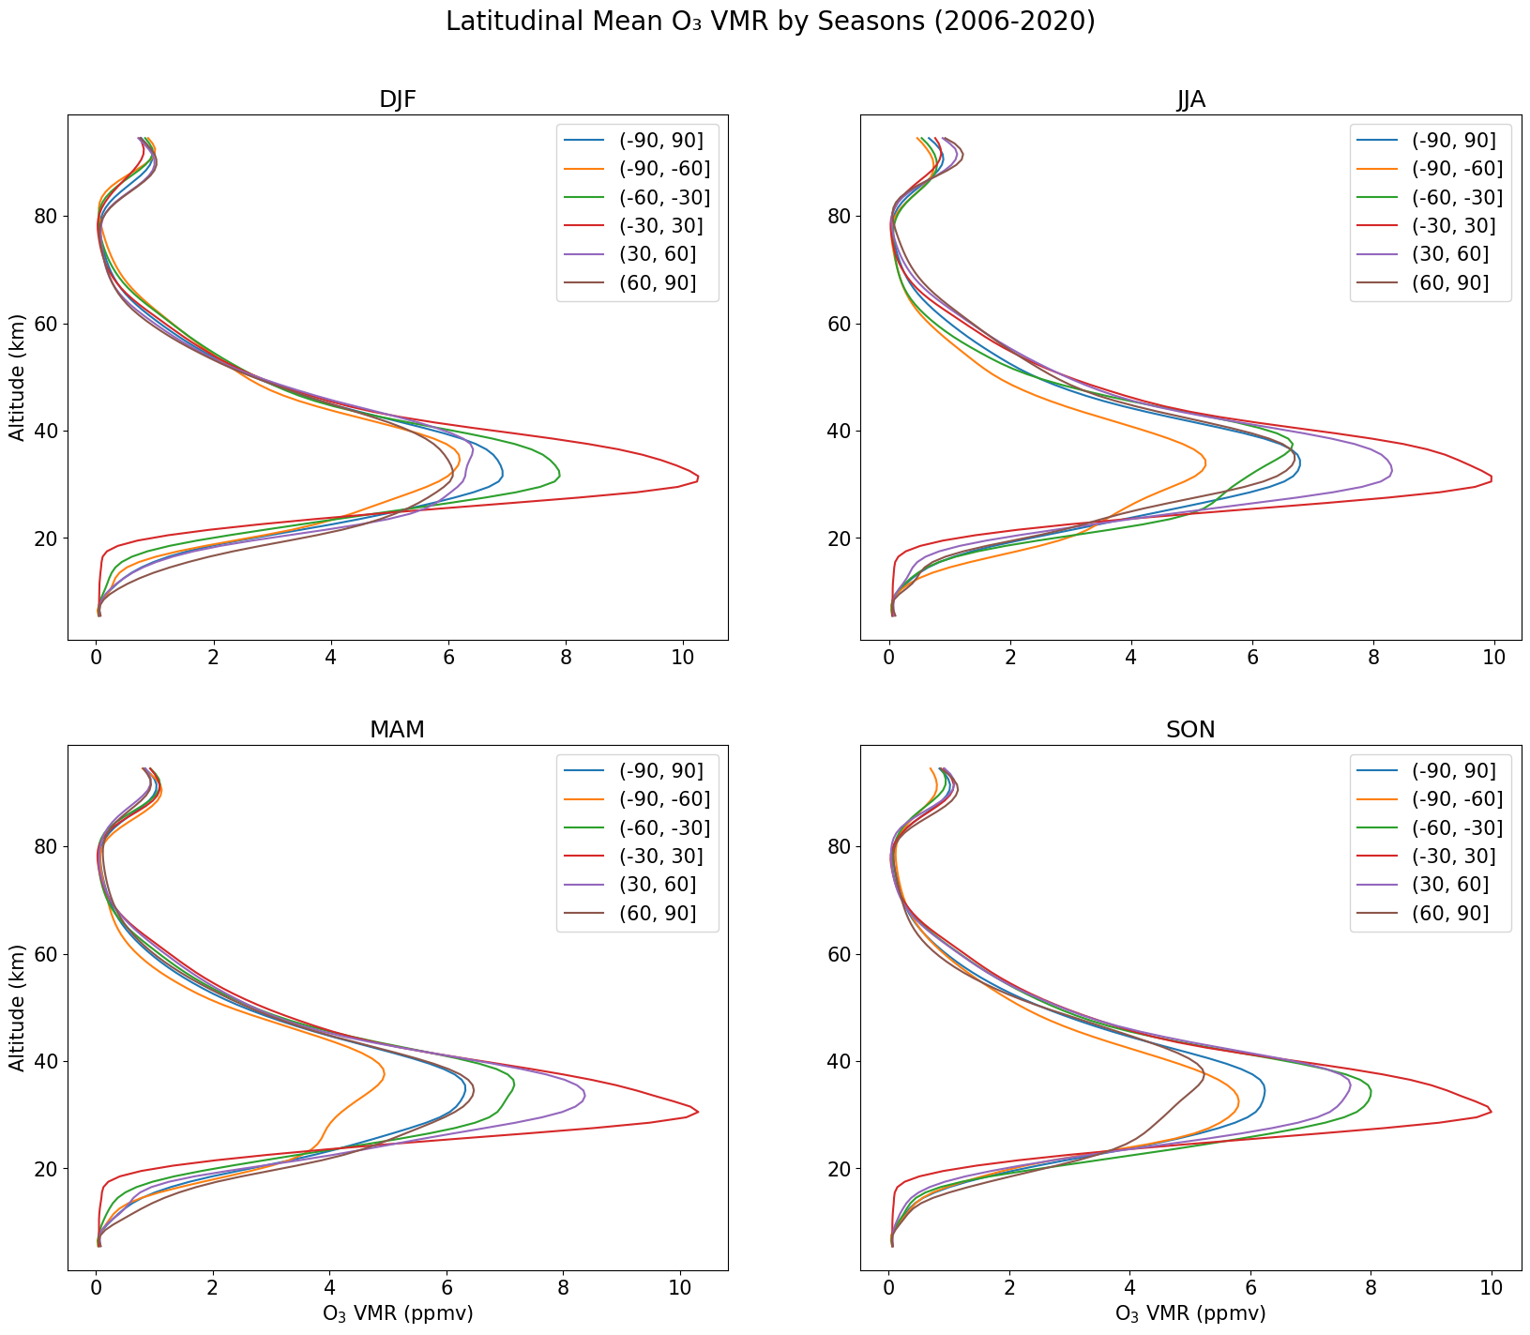
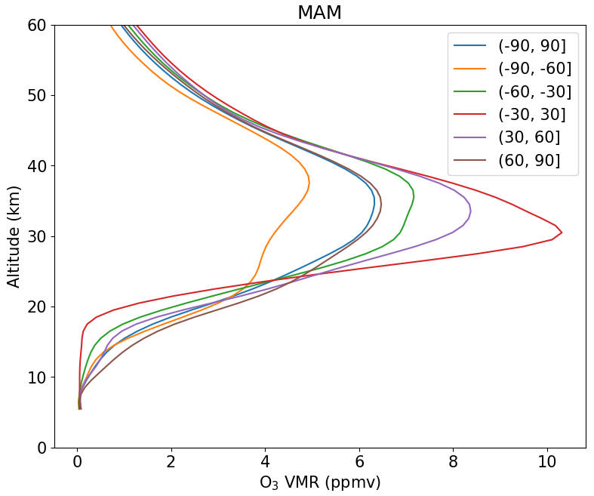
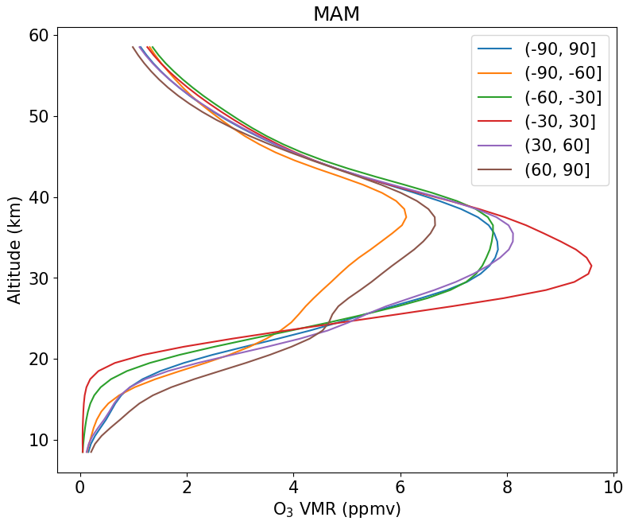
ACE-FTS
Some discrepancy
OSIRIS
Notes:
Global is lower, tropics is higher, southern latitude is lower

Slide 8
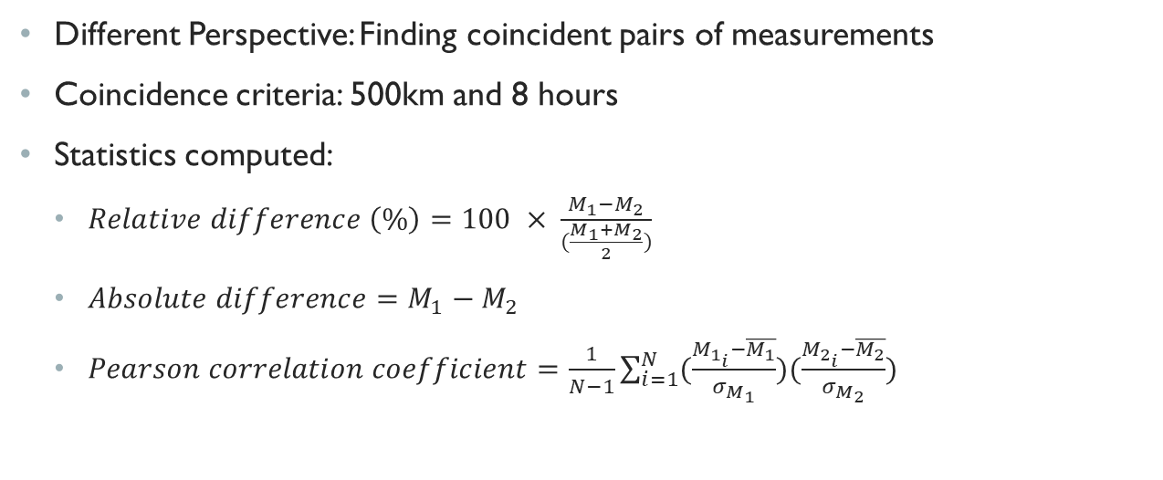
INDIVIDUAL MEASUREMENT COMPARISONS
Different Perspective: Finding coincident pairs of measurements
Coincidence criteria: 500km and 8 hours
Statistics computed:
$Relative difference \left(\%\right)=100 × \frac{M_{1}−M_{2}}{(\frac{M_{1}+M_{2}}{2})}$
$Absolute difference=M_{1}−M_{2}$
$Pearson correlation coefficient=\frac{1}{N−1}\sum_{i=1}^{N}{(\frac{M_{1_{i}}−\overline{M_{1}}}{σ_{M_{1}}})(\frac{M_{2_{i}}−\overline{M_{2}}}{σ_{M_{2}}})}$

Slide 9
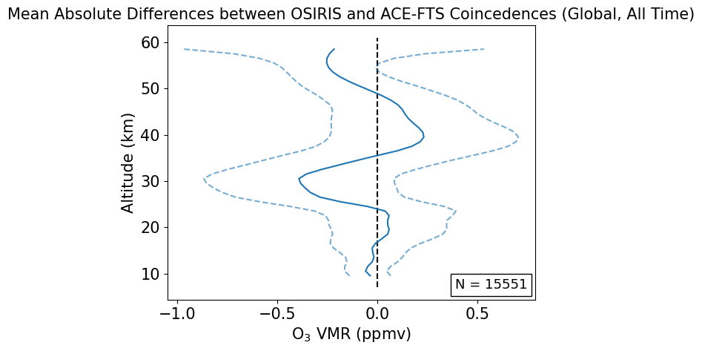
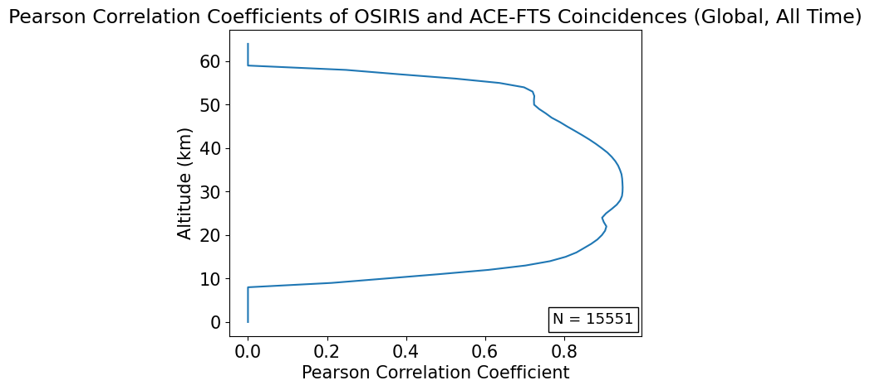
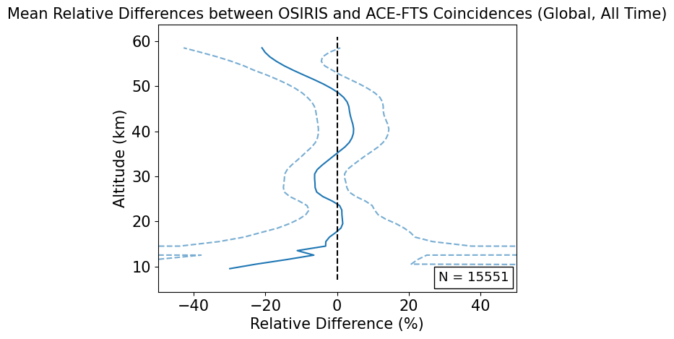
OSIRIS vs ACE-FTS OZONE PROFILE PLOTS

Slide 10
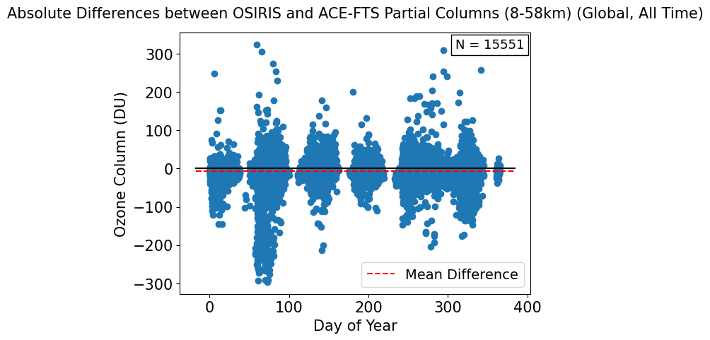
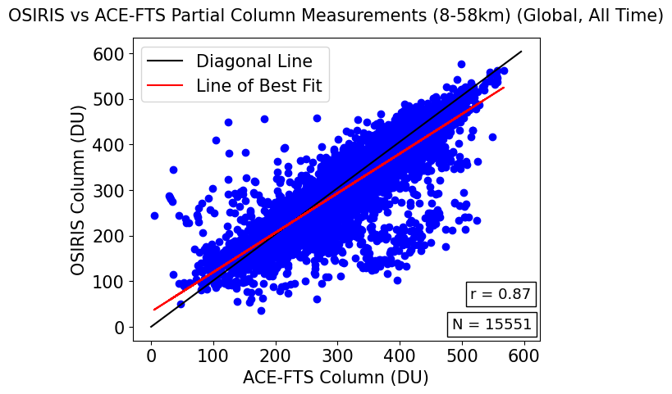
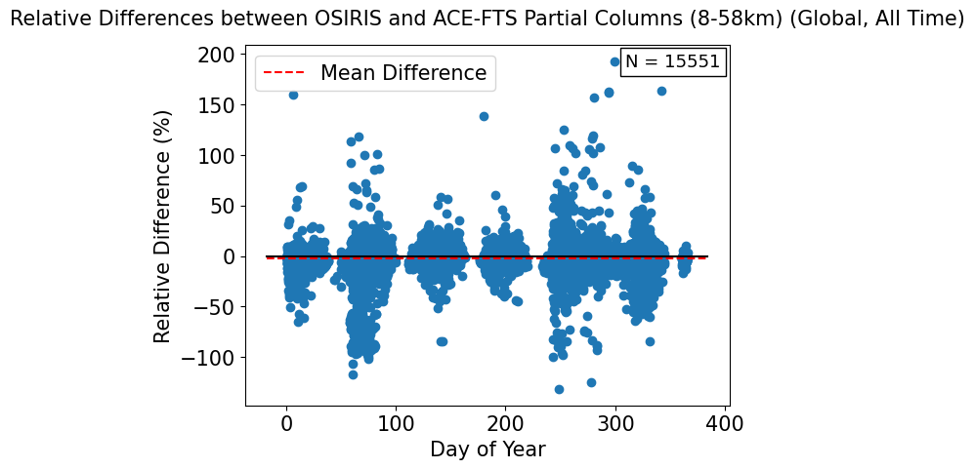
OSIRIS vs ACE-FTS OZONE Partial COLUMN PLOTS

Slide 11
POTENTIAL Next stepS
Analysis of the Averaging Kernels of the PEARL FTIR instrument to allow for more accurate comparisons.
Refining coincidence criteria
Examining seasonality of agreement
Examining agreement overtime

Slide 12
REFERENCES
Bernath, P. F., et al. (2005), Atmospheric Chemistry Experiment (ACE): Mission overview, Geophys. Res. Lett., 32, L15S01, doi:10.1029/2005GL022386
McLinden, C. A., and Coauthors, 2012: OSIRIS: A Decade of Scattered Light. Bull. Amer. Meteor. Soc., 93, 1845–1863, https://doi.org/10.1175/BAMS-D-11-00135.1
Llewellyn, E. J., et al. 2004. The OSIRIS instrument on the Odin spacecraft. Canadian Journal of Physics. 82(6): 411-422. https://doi.org/10.1139/p04-005
https://eureka.physics.utoronto.ca/Eureka2020/Our_Instruments.html
https://uwaterloo.ca/atmospheric-chemistry-experiment/instruments/ace-fts
Ross J. Salawitch, Laura A. McBride, Chelsea R. Thompson, Eric L. Fleming, Richard L. McKenzie, Karen H. Rosenlof, Sarah J. Doherty, David W. Fahey, Twenty Questions and Answers About the Ozone Layer: 2022 Update, Scientific Assessment of Ozone Depletion: 2022, 75 pp., World Meteorological Organization, Geneva, Switzerland, 2023.

Slide 13

ANY QUESTIONS?

Slide 14

THANK YOU FOR YOUR TIME

